Slide 1
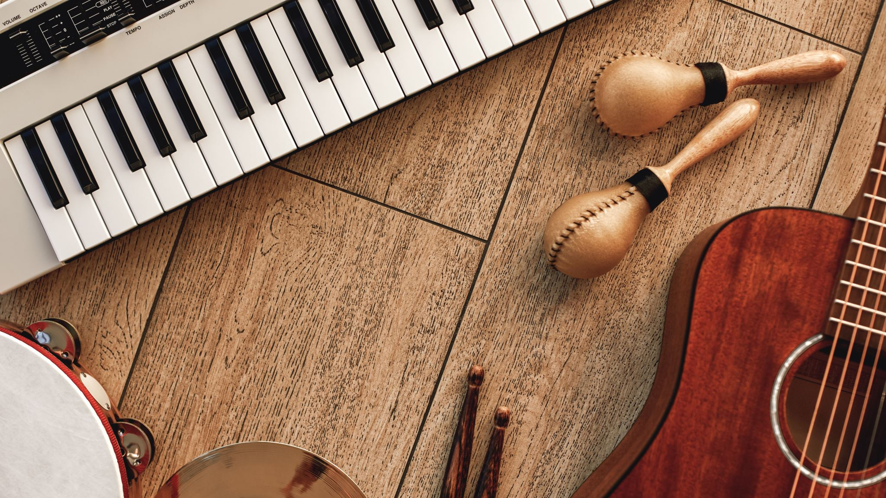


A Music Recommendation Application
RAAG
Presented by: Dwij Dua
Megha Garg
Minu Ahlawat
Taxil Savani

Slide 2

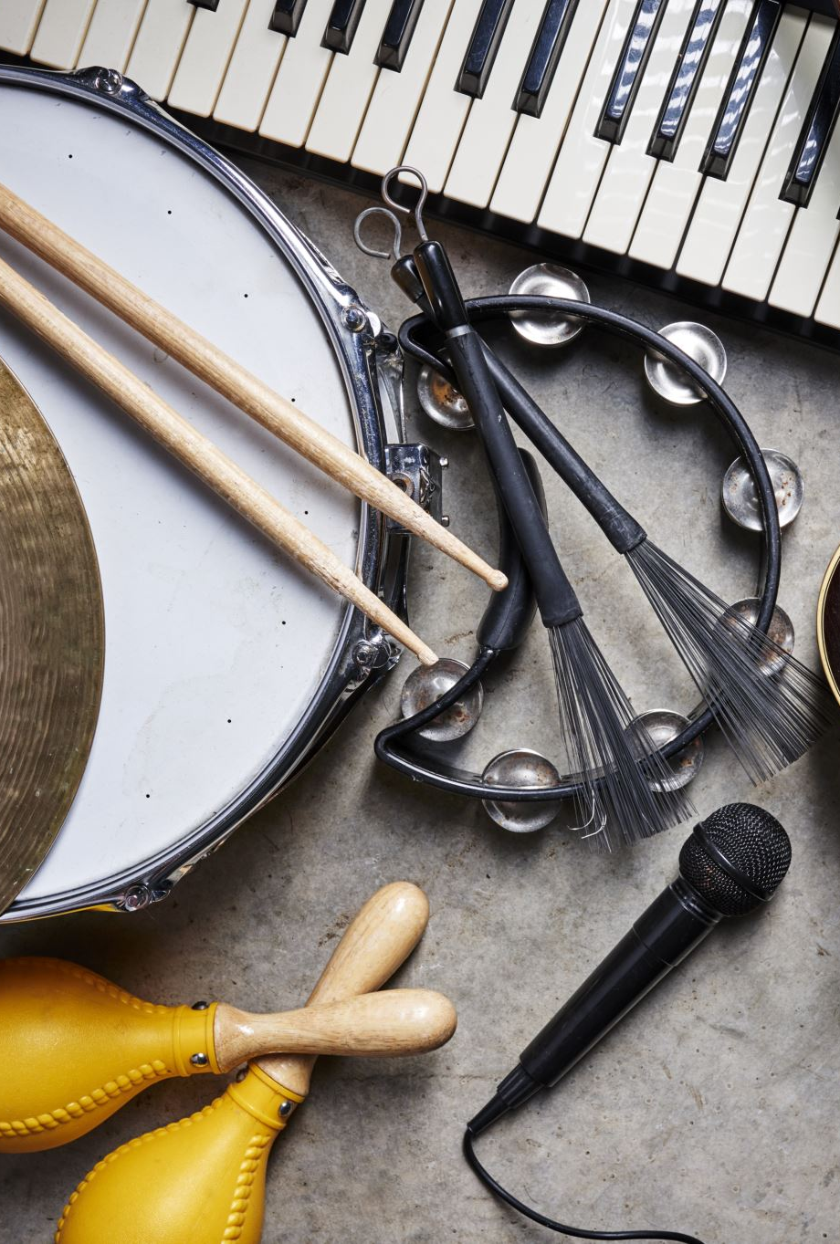
This project's goal is to create a music recommendation system. Users' musical preferences will be determined by analyzing their interactions while using the device. This allows the user to predict which artist or group will appeal to them at any particular time. Based on the qualities of the music that has been heard previously, the program will be able to forecast and then present the suitable songs to its users.
Description
z

Slide 3

Features
Based on different independent features we will recommend music.
End-user login privilege
Admin privilege
z

Slide 4
Predictions Based on Factors
Genre
Artist
Year
Popularity
z

Slide 5
Technical Stack
Java
Python
Javascript / JQuery
Wix / Wordpress
MySql
z

Slide 6

Repository Link
z
https://github.com/garg-meghaa/Raag

